Slide 1
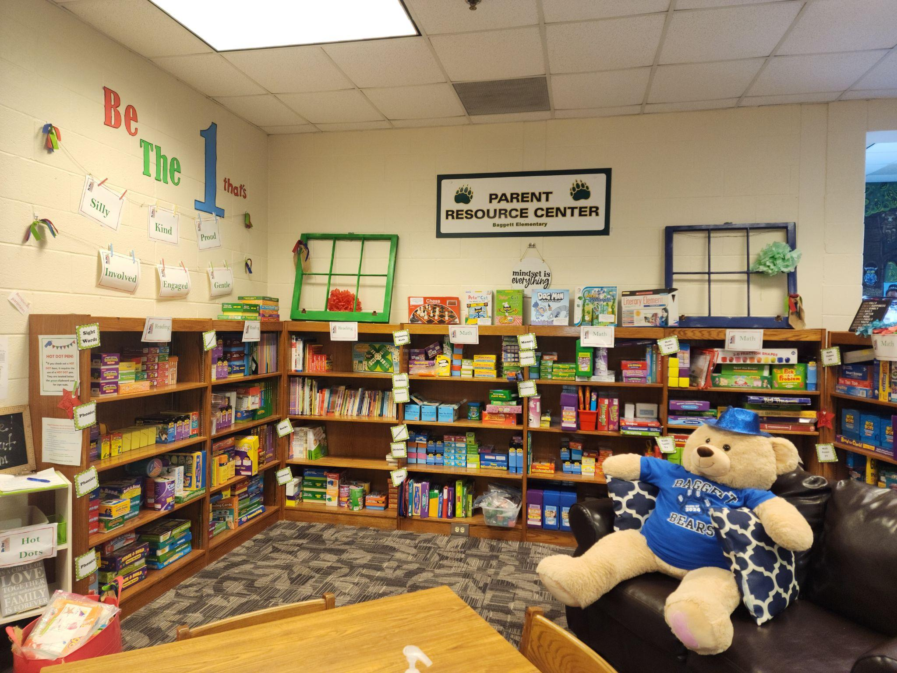
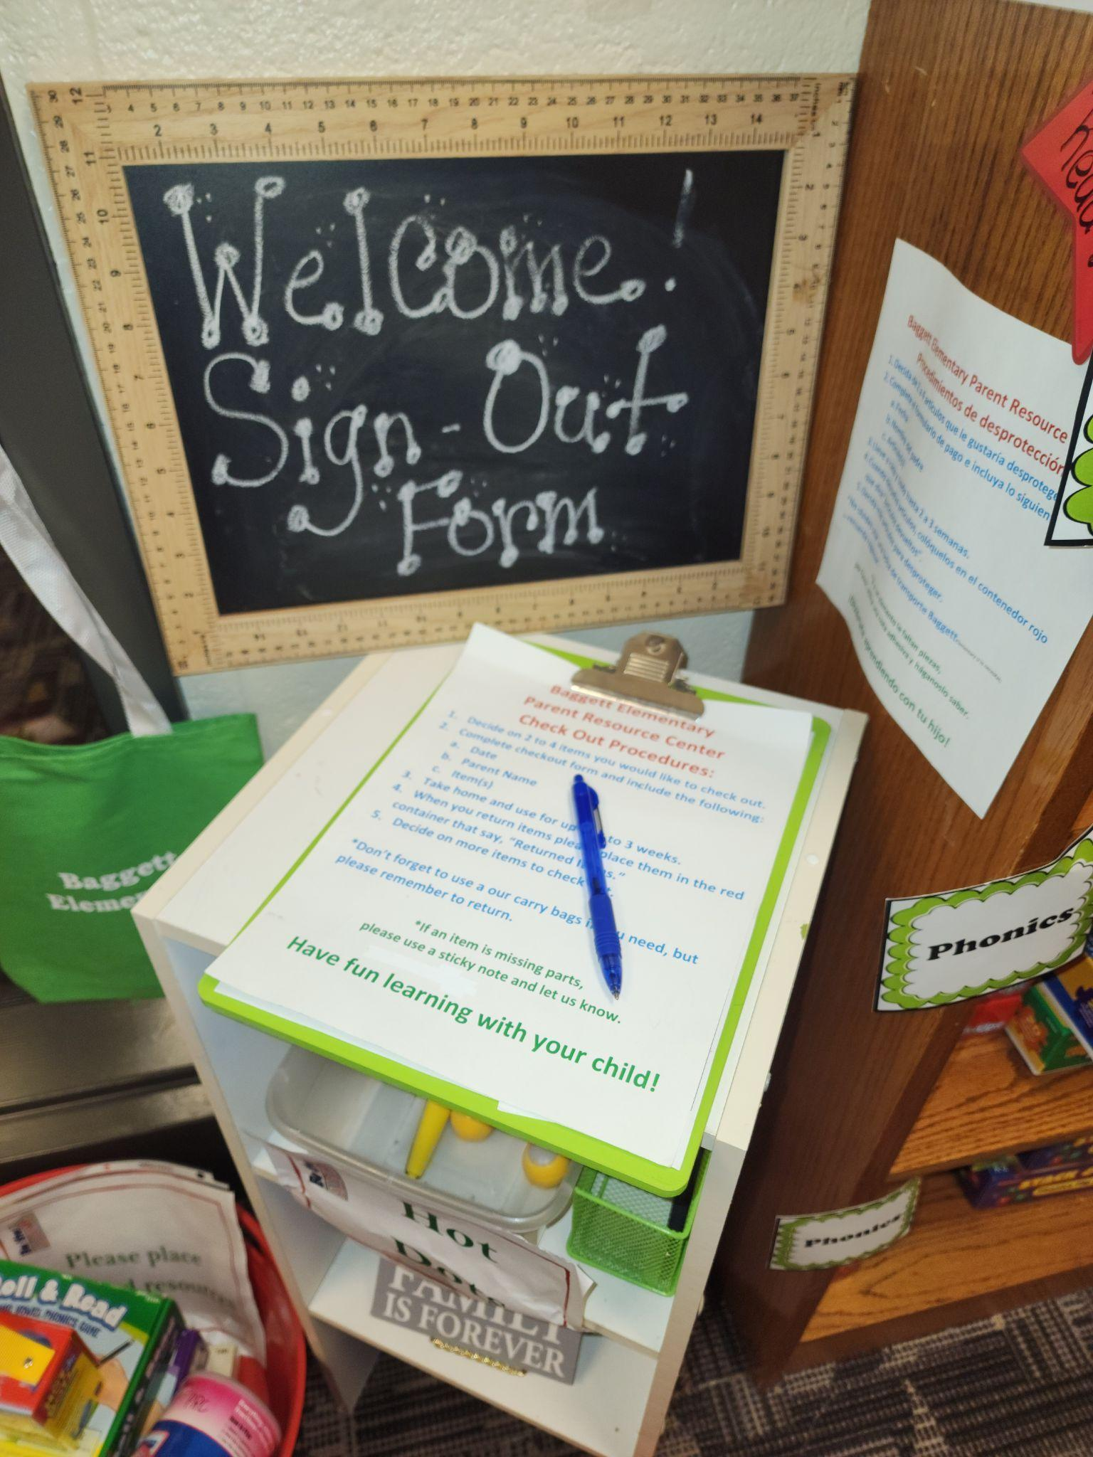

Check-out Procedures
1. Select item to check-out.
2. Sign the item out on the clipboard.
3. Package item in the check out bags if needed.
Return Procedures
1. Check the returned box on the clipboard
when you bring the item back.
2. Place the materials in the return spot.
3. Please return the items within two weeks.
Assistance
If you need assistance selecting an item, please ask the office to call Mrs. McCullough,.
Thank you for your interest in the Baggett Elementary School Parent Resource Center!
If you have suggestions for additional materials, please email Mrs. Gray at jholmes@paulding.k12.ga.us
All materials may be used for FREE and keep them as long as you need! :)
Math and Reading
The Parent Resource Center includes
materials for all grade levels to support students in reading and math.
Math– The math section includes
games and activities to support the math programs of the school. Materials include board games, “Can Do” activities, and other hands on activities.
Reading– The reading section
includes a variety of materials to support reading. Materials include games and hands on activities that work on a variety of reading skills including reading fluency, comprehension and much
more!

Slide 2

Baggett Elementary
General Information
Parent Resource Center
The Parent Resource Center is
open to parents, teachers,
grandparents, and guardians!
• The center is located in the
Media Center
• The Parent resource center is open between 7:30 and 3:30
Daily.
• Reading and Math Materials are available for all grade levels.
• Your child’s teacher can request material for you through Baggett’s Instructional Lead Teacher, Lisa Gray.
Reading and Math Resources and Games for Checkout
For more information about the
Baggett Elementary
Parent Resource Center
Contact
Julie Holmes
Email: jholmes@paulding.k12.ga.us
Telephone: 770-443-4269
Ext: 20024
Baggett Elementary
948 Williams Lake Rd.
Powder Springs, Georgia 30127
Telephone: 678-460-1570

Slide 3
Baggett Elementary Parent Resource Center
Location -
Baggett Media Center
Hours - 7:30 a.m. - 3:00 p.m. Open Daily
Baggett Elementary offers a Parent Resource Center. New learning resources, activities, and helpful information is added to the resource on an on-going basis. Materials are chosen and purchased with Title I funds, based on input and requests from parents and teachers, and are available for parents to borrow for free. There are also computers and a printer available for your use in our Parent Center. We share updates on materials and resources in the Parent Resource Center during our monthly parent meetings and workshops throughout the year. Flyers, phone calls and articles in the school newsletter encourage parents to check out materials to help their child at home.
PRC Procedures: Parents are invited and welcome to come into the PRC located in the Baggett Media Center to browse and look for grade-level specific games, resources, and activities to check out for home use with their children. Once a desired item is located, parents are encouraged to check out the item for use. Parents will log the items they have selected on any PRC Sign-Out sheet located at the end of the shelves. Once the item is returned, it is marked off the sheet and returned to proper storage location for future checkouts. We also have a virtual checkout process if parents are unable to come inside the building. This link is located on the Baggett Elementary website. Parents can fill out the form and turn it into the homeroom teacher, or the ILC.
Parent Resource Room contact – Title I Parent Engagement Coach, Julie Holmes, jholmes@paulding.k12.ga.us or (770)443-4269

Slide 4
If you have questions or concerns, or would like more information about the Title I program
or the Parent Resource Center………
Contact the Title I Elementary Parents Engagement Coach,
Julie Holmes
jholmes@paulding.k12.ga.us
(770)443-4269

